Slide 1

MATHEW

Slide 2
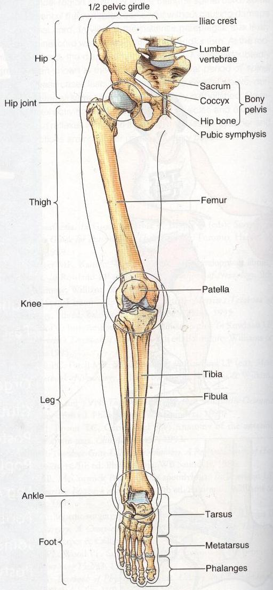
Introduction
Lower limb is designed to support the body, its weight & it is mainly responsible for gait
Organization of the Lower Limb
Lower limb has four parts
Hip (gluteal region)
Thigh
Knee
Leg
Ankle
Foot
MATHEW

Slide 3
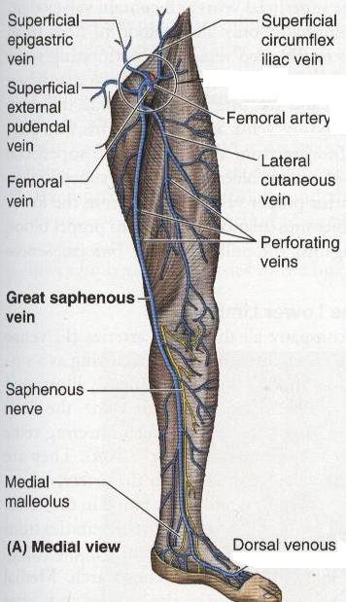
Superficial fascia of the lower Limb
Fatty & Membranous layers
Superficial nerves, superficial vessel, & superficial inguinal lymph nodes are present b/w these two layers.
Nerves:
Lat. Cut. N of thigh
Med. Cut. N of thigh
Intermed. Cut. N of thigh
Femoral br. of Genitofemoral n
Ilioinguinal n
Branch from obturator n
Patellar plexus
Veins:
Great Saphenous Vein
Small Saphenous Vein
MATHEW

Slide 4
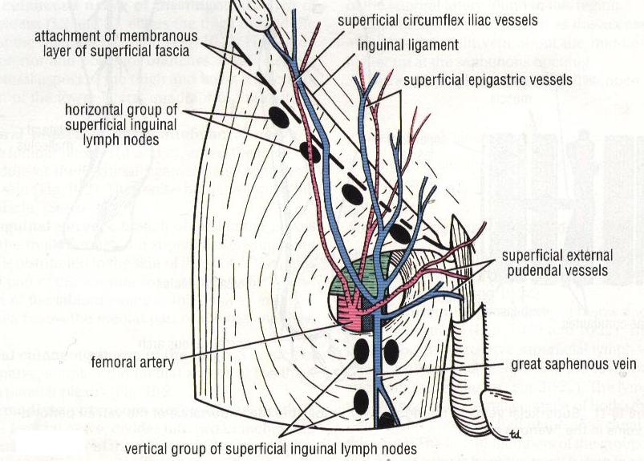
Superficial Inguinal Lymph Nodes
Horizontal Group
Vertical Group
MATHEW

Slide 5
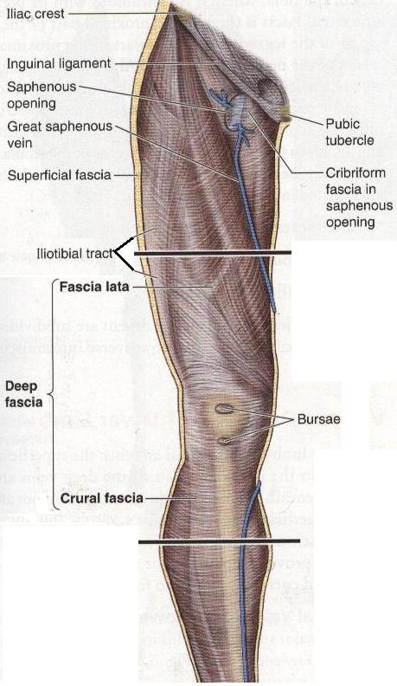
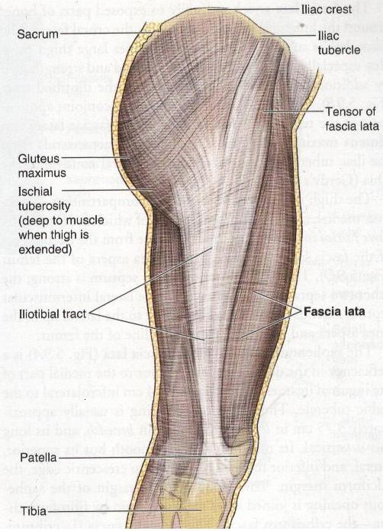
Deep fascia of the lower limb
Fascia Lata (deep fascia of the thigh)
Crural Fascia (deep fascia of the leg)
Iliotibial Trat
Saphenous Opening
MATHEW

Slide 6
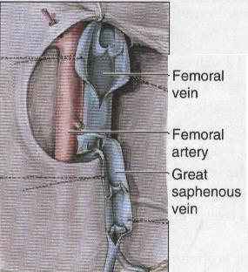
Saphenous Opening
An opening or a gape in the deep fascia in the front of the thigh 4cm inferolateral to the pubic tubercle.
The saphenous opening is covered by loose CT called CRIBRIFORM fascia.
MATHEW

Slide 7
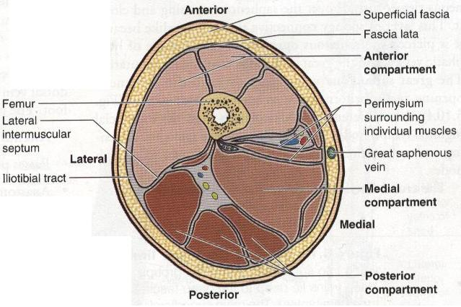
Fascial Compartments of the Thigh
Three fascial septa pass from the inner aspect of the deep fascial sheath of the thigh to the linea aspera of the femur. Making Anterior posterior & Medial compartments. Having muscles, nerves & arteries.
MATHEW

Slide 8
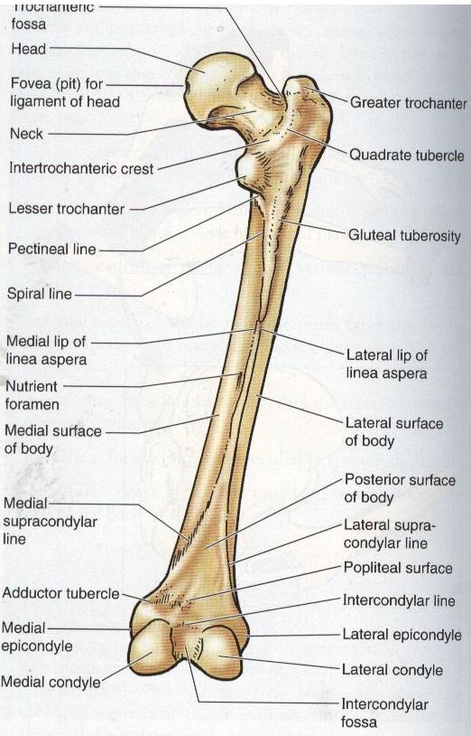
MATHEW

Slide 9
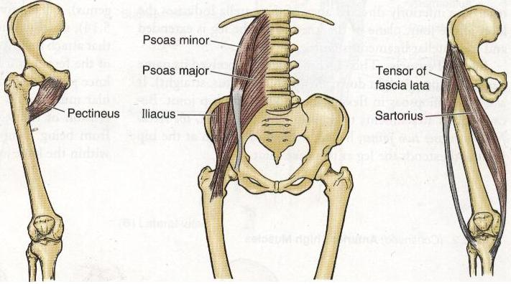
Muscles of the Anterior Fascial Compartments of the Thigh
MATHEW

Slide 10
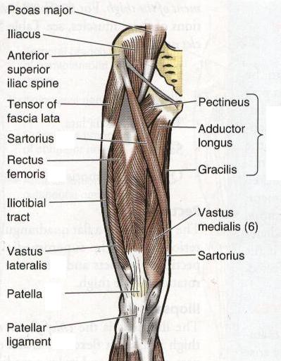
Muscles of the Anterior Fascial Compartments of the Thigh
MATHEW

Slide 11
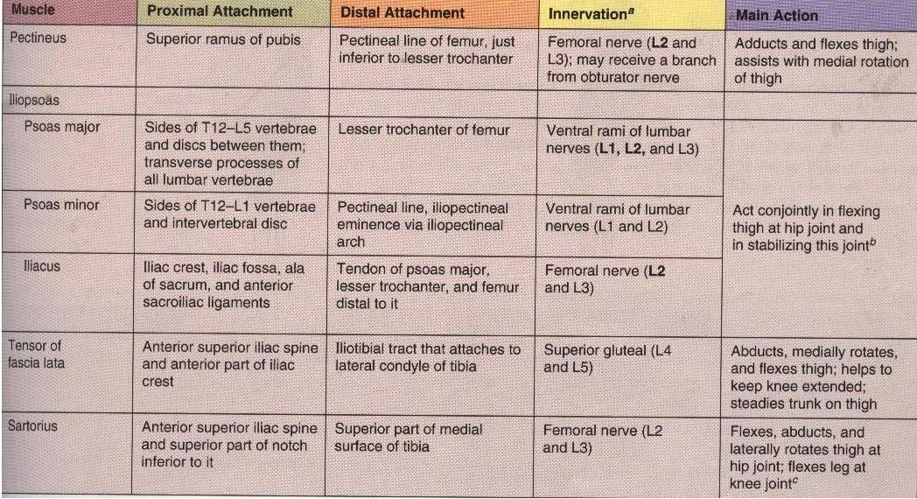
Muscles of the Anterior Fascial Compartments of the Thigh
MATHEW

Slide 12
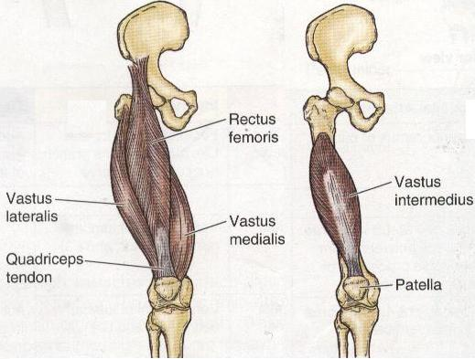
Muscles of the Anterior Fascial Compartments of the Thigh
Quadriceps Femoris
MATHEW

Slide 13
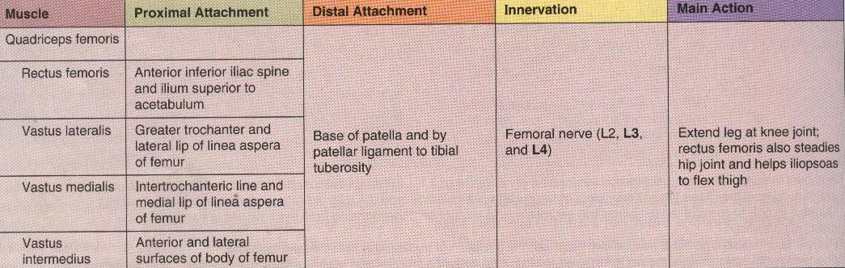
Muscles of the Anterior Fascial Compartments of the Thigh
Quadriceps Femoris
MATHEW

Slide 14
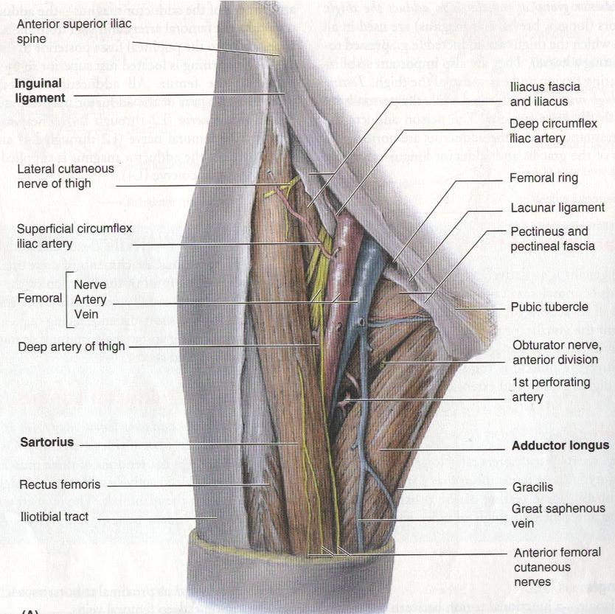
Femoral Triangle
A triangular depressed area situated in the upper part of the medial aspect of the thigh just below the inguinal ligament
MATHEW

Slide 15
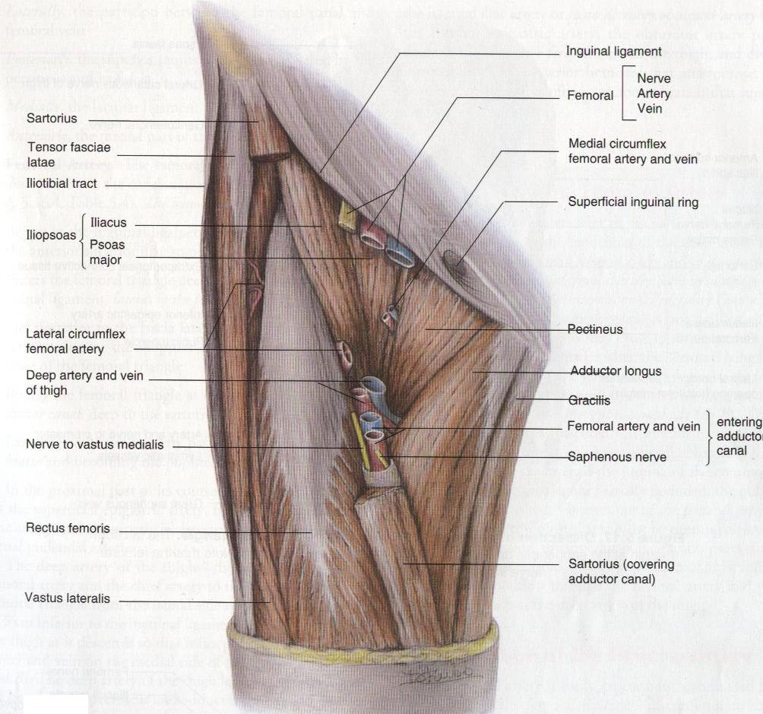
mathew

Slide 16
Blood Supply of the Anterior Fascial Compartments of the Thigh
Femoral Artery
main artery of lower limb
Origin
Continuation of Ext. Iliac artery below the inguinal ligament. Enters the thigh midway between the ant. Sup. Iliac spine & pubic Symphysis
Termination
Ends at the opening in the adductor magnus muscle by entering the popliteal fossa as popliteal artery
Branches
Superficial:
Sup. Ext. Pudendal
Sup. Epigastric
Sup circumflex iliac
Deep:
Profunda femoris
Deep Ext. pudendal
Descending genicular
Lat. Cir femoral
Med. Cir. Femoral
4 perforating a
mathew

Slide 17
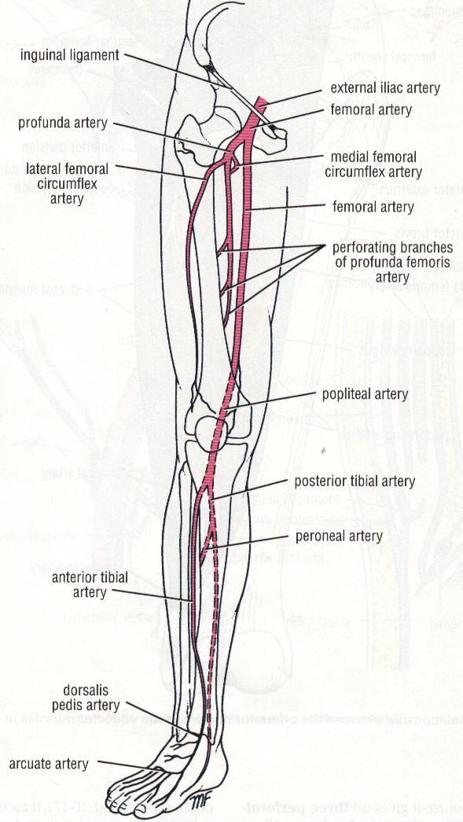
MATHEW

Slide 18
Femoral Nerve
Largest branch of lumbar plexus
MATHEW

Slide 19
Femoral Sheath
Inferior prolongation of transversalis & iliopsoas fascia
MATHEW

Slide 20
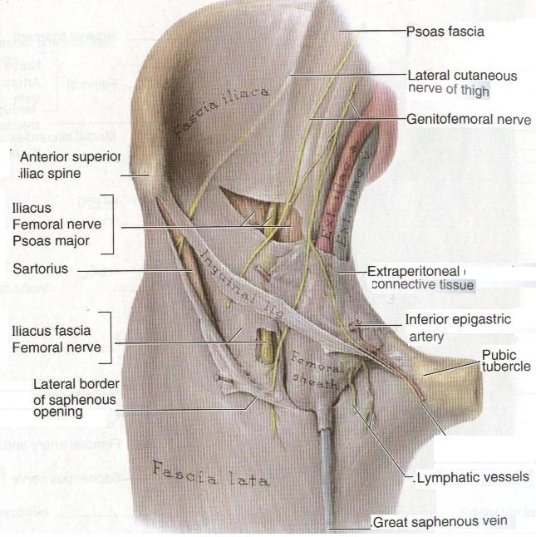
MATHEW

Slide 21
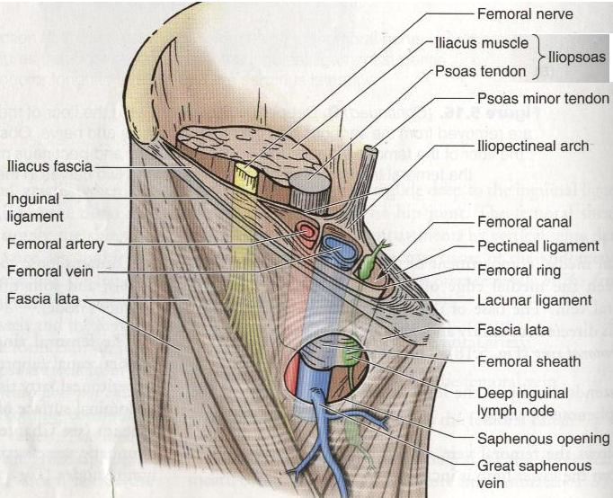
MATHEW

Slide 22
The femoral sheath does not enclose the femoral nerve
MATHEW

Slide 23
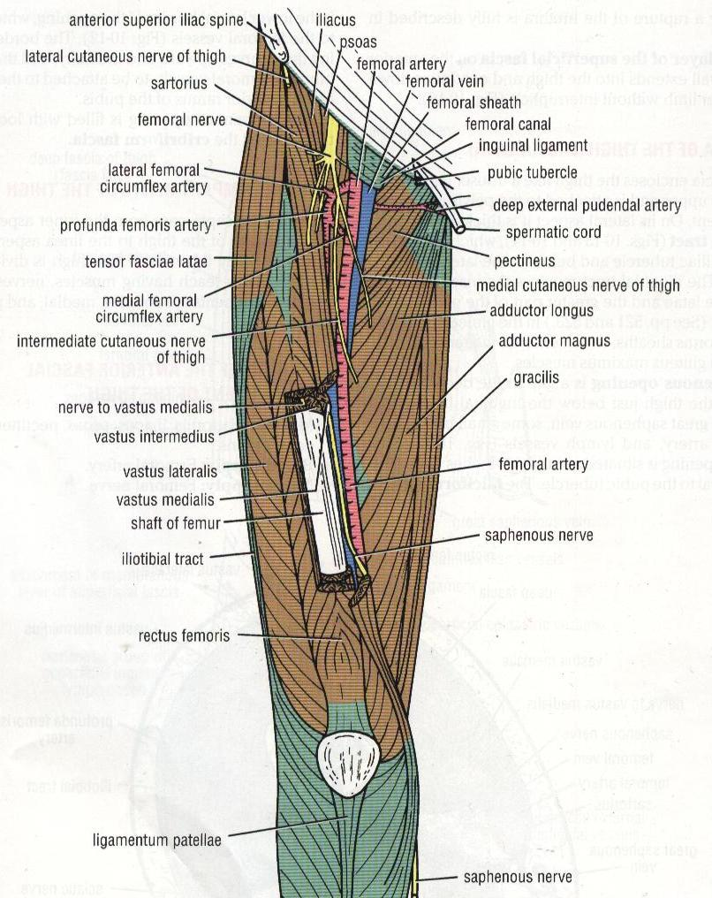
The adductor (subsartorial) canal
An intermuscular cleft situated on the medial aspect of the middle 3rd of the thigh
Contents of
adductor canal
Femoral artery & vein
Deep lymph vessels
Saphenous nerve
Nerve to vastus med
Obturator nerve
MATHEW

Slide 24
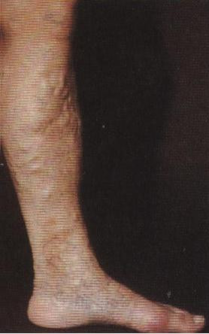
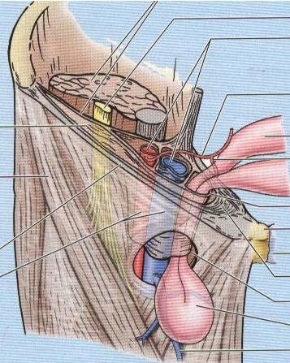
Clinical Notes
Femoral artery & vein Catherization
Varicose veins
Veinous cut down
Saphenous vein in coronary bypass surgery
Femoral hernia
MATHEW

Slide 25

MATHEW

